Slide 1

Online grocery sell
Kharidobecho.com
Presented by:- presented to
kamleshkumar saini 53003170069 (ma’am DR Manisha Divate)
Saurabh dubey 53003170032

Slide 2
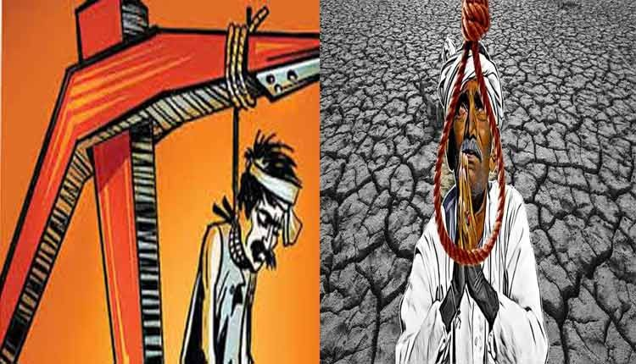
why we choose this topic?
Farmer sucide
Farmer empowerment

Slide 3
Aim:-
To help every farmer of the india.

Slide 4
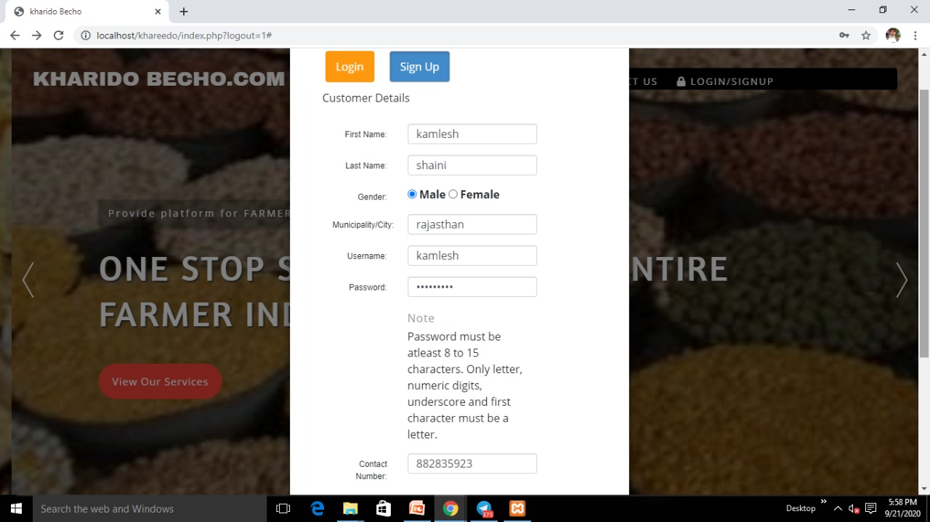
introduction

Slide 6
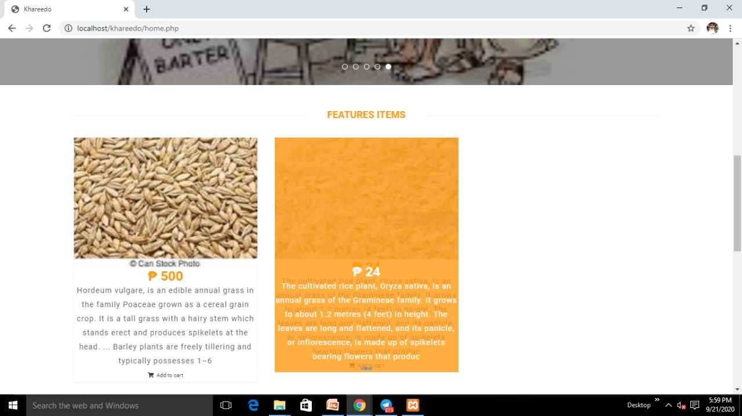

Slide 7
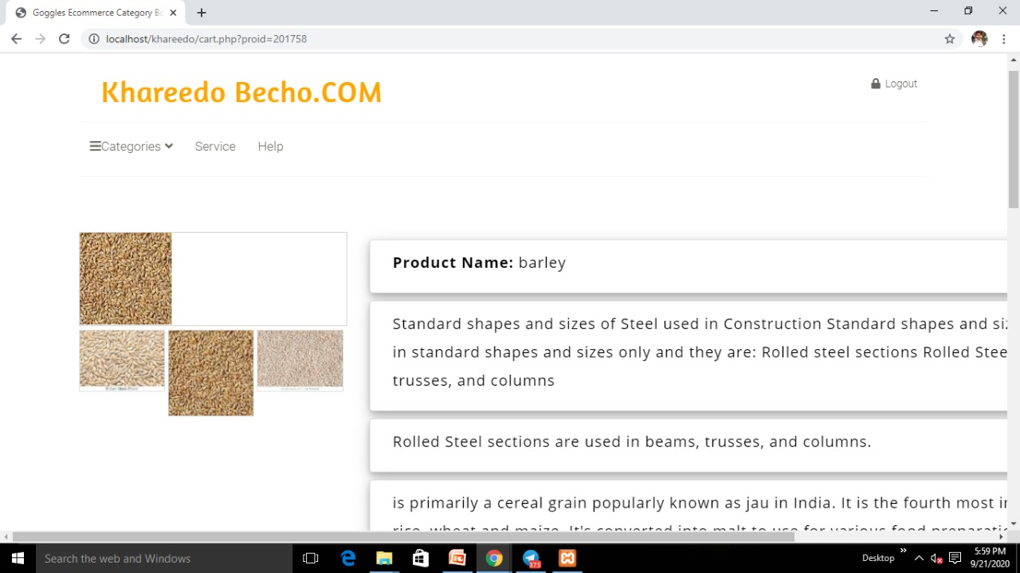

Slide 8
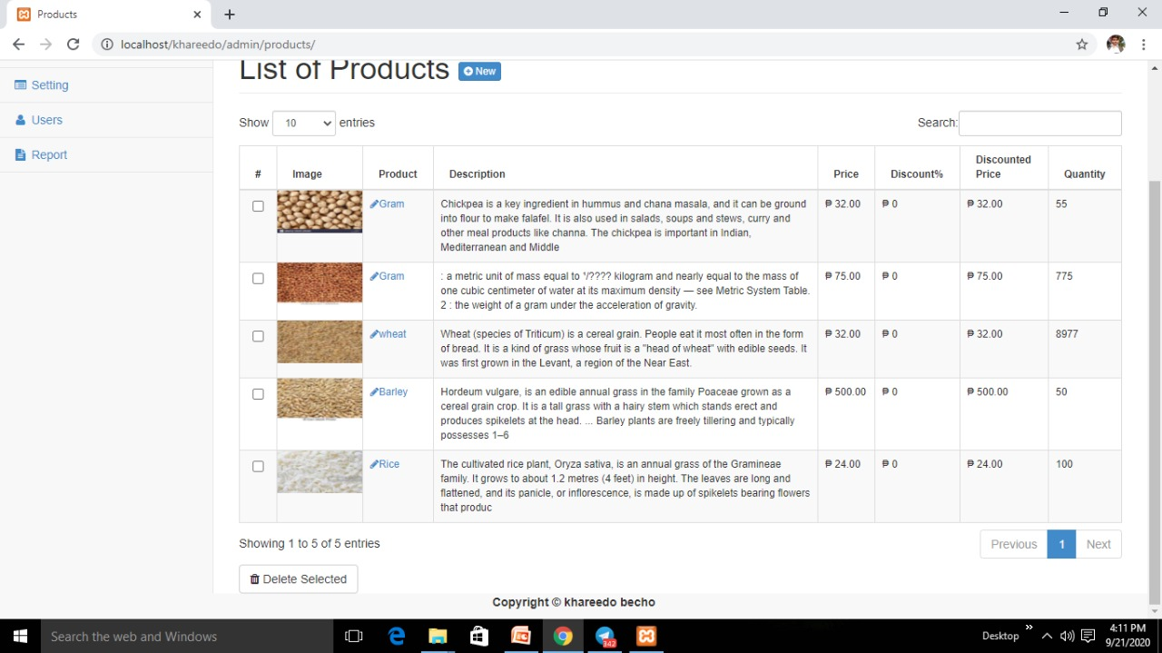
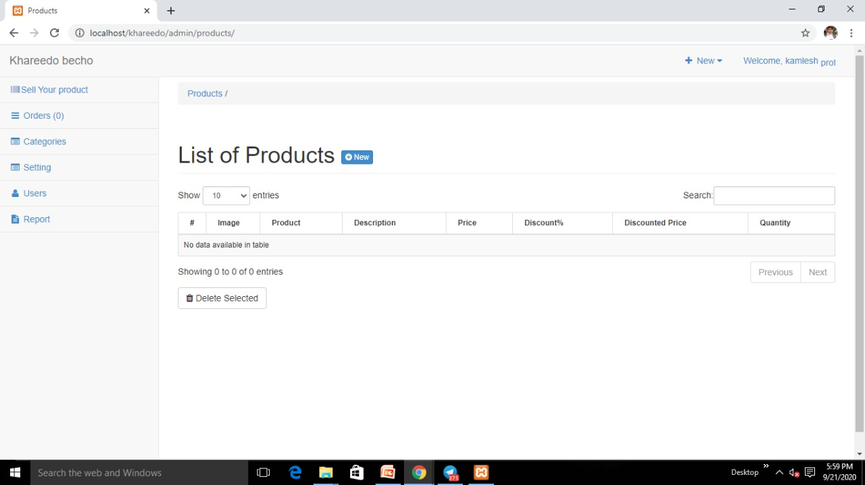

Slide 10
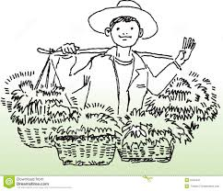

Slide 11
Weakness:-
No assurance of quality
Fraud is possible
Unskilled work force
Transportation is slow

Slide 12
Strength:-
Sell groceries (anytime) and buy groceries (anytime) as per need.
No need of money.
Nolimit of groceries.

Slide 13




Competitors:-
This Photo by Unknown Author is licensed under CC BY-SA
This Photo by Unknown Author is licensed under CC BY-SA
This Photo by Unknown Author is licensed under CC BY-NC-ND
This Photo by Unknown Author is licensed under CC BY-NC

Slide 14

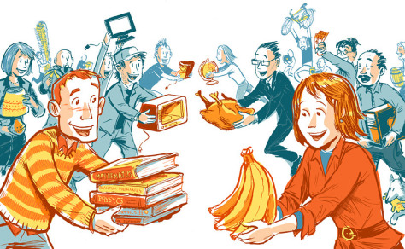
FUTURE UPDATE:-BARTER SYSTEM
This Photo by Unknown Author is licensed under CC BY

Slide 15
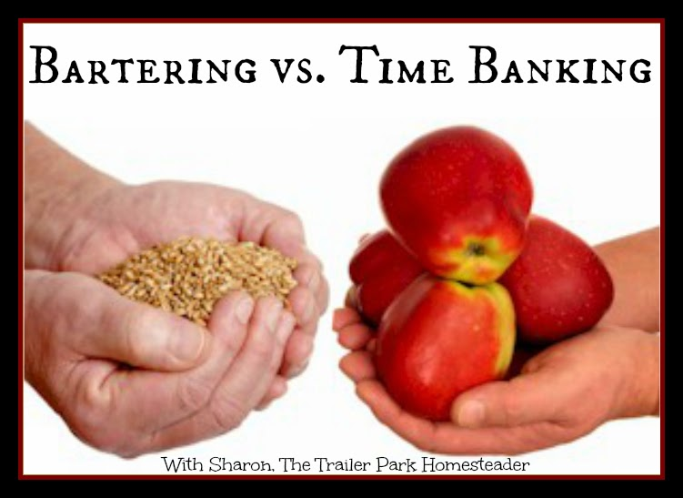

Slide 16

Kharidobecho.com
Kharidobecho.com
Thank you

